Slide 1
STARTUP FAILURE
آسیه صفازاده مدیر سرمایه گذاری سلامت شرکت سرمایه گذاری خطرپذیر شناسا
محمد مهدی سالاری کارشناس ارزیابی سرمایه گذاری سلامت شرکت سرمایه گذاری خطرپذیر شناسا

Slide 2
For every 1,000 startups that meet with a venture capitalist, only two get funding. And for every funded startup, only one in 10,000 ends up being worth $1 billion.
75% in the first year
50% in the first 5 year
70% in 10 year

Slide 3
Failure rate of startups

Slide 4
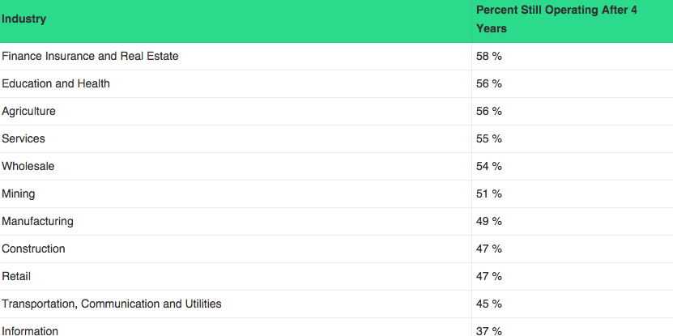
The most successful startups

Slide 6
You Did Not Lose
Unless You
Learned Nothing

Slide 7
Completes Success Cycle
(Failure -> Learning -> Success)

Slide 8
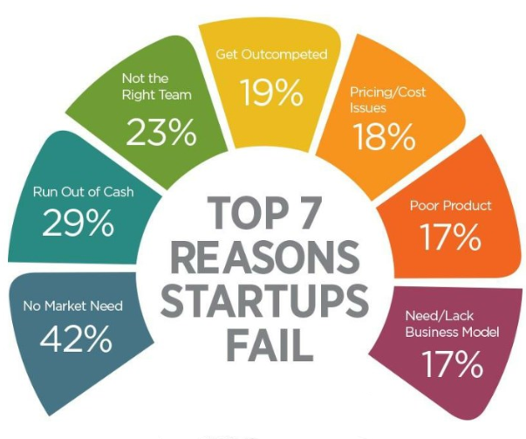

Slide 9
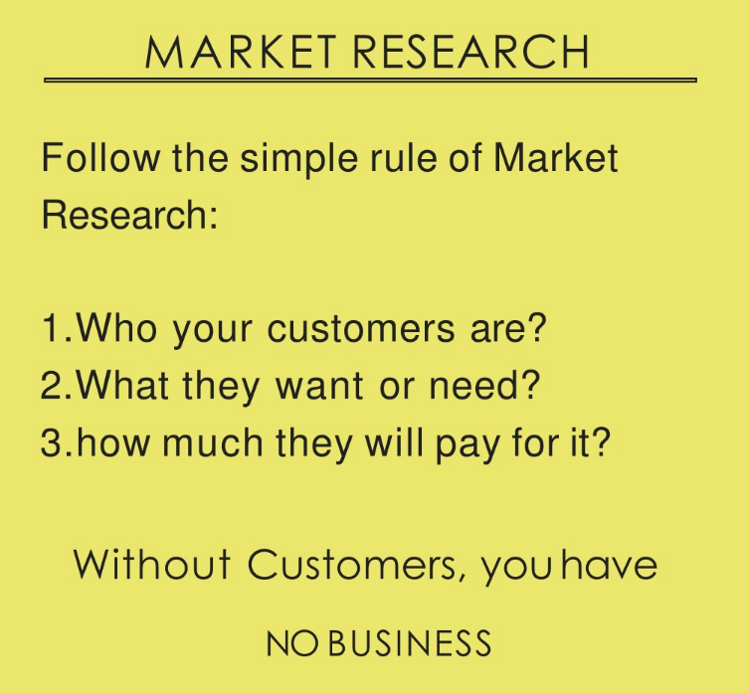
Failure to find unsolved customer pain
Promising Idea:
Don't start your company until many people are willing to pay now to get your product sooner.

Slide 10
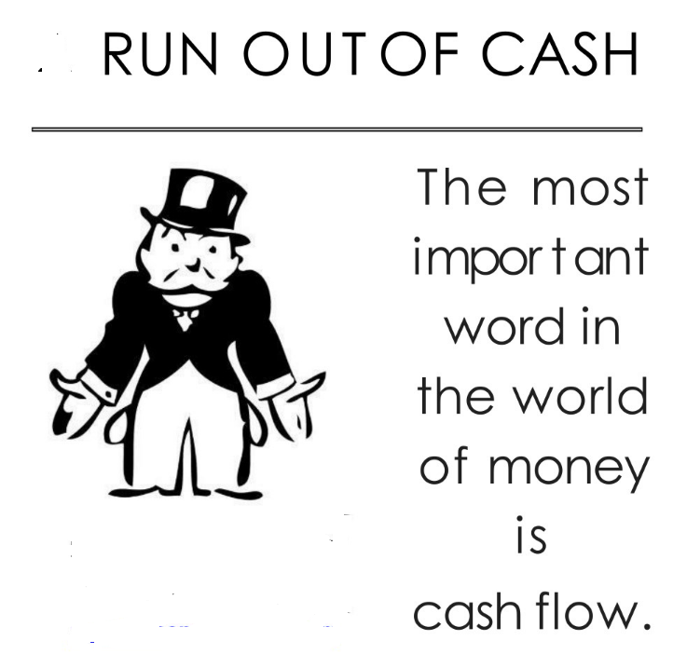
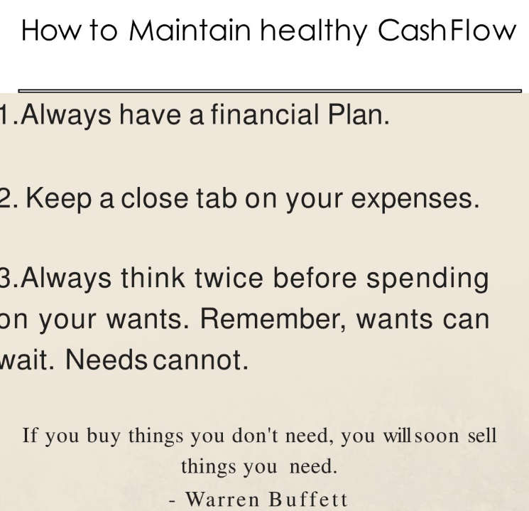
lack of cash Ignoring cash burn
Many entrepreneurs ignore the rate at which they are burning through cash
→ Spend only on essentials
→ Start fund raising at least six months before their companies run out of cash..

Slide 11
Weak team, poor leadership
The simple reality is that if you are not a great leader, it is hard to learn to become one.

Slide 12
Get out Competed
Afraid of steal their idea
Impress their peers
Nobody will buy unless it is perfect

Slide 13
Cost strategy

Slide 14
Poor Product
get feedback on prototypes
build an inexpensive prototype of your product, getting feedback on it, and use that input to build a new one. You should repeat this learning loop until potential customers demand your product.

Slide 15
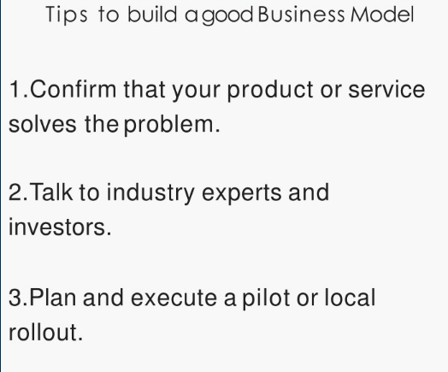
Business Model

